Slide 1
Calculus Project
Functions from data
Member:
Mukand Krishna
Bahadur Khan
Abdul Bari
Muhammad Hassan
Bhavnesh Deep

Slide 2
Fitting curves to data and Finding mathematical model
Figure 1a suggests that the relationship between x and y is linear, so in absence of additional information we will use linear model y = mx + b.
Scatter plot of U.S. population growth in Figure 2 suggests nonlinear relationship, so we look for a nonlinear function for the model. There are theories in the study of population growth which suggest that in absence of environmental constraints, populations of people can be modeled by equations P = Poe**kt , so in this case we look this equation to model the data.
The relationship between two variables x and y can be calculated by equation y=f(x) called mathematical model. If relationship between x and y is known to be linear but that accuracy limitations in the measuring devices produce a scatter plot. A good approach is to look for a linear equation y = mx + b whose graph more accurately describes the linear relationship.

Slide 3
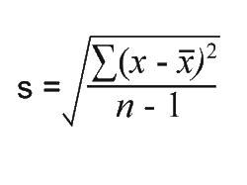
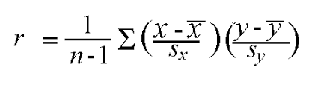
Question#2: we used 2 methods. In 1st method we calculated regression line using calculator. In 2nd method we took the Mean Values of X and Y. Then we calculated STANDARD DEVIATIONS of Both X and Y using the mean values of x and y and number of values. Then by using standard deviations and mean values we calculated CO-RELATION COEFFICIENT i.e., R. We find Slope by R and standard deviation of x and y. Using the values we regression line equation of the form.
Linear modeling
Common method for finding a linear model is line y = mx +b in which the sum of the squares of the residuals is as small as possible. This is called the least-squares line of best fit or the regression line.
Question#1
As we have two lines we had their x and y values. The differences of two points for both x and y values which are called residuals. Take square of residuals we obtained and as sum of sq of residuals of line#2 is small, so line#2 is regression line in figure 4.

Slide 4
How good is linear model
.
It is possible to compute a regression line, even in cases where the data have no apparent linear pattern. Thus, it is important to have some quantitative method of determining that linear model is appropriate for data. The common measure of linearity in data is called the CO-RELATION COEFFICIENT i.e., r.
The value of r has same sign as slope of regression line. If r = ±1, then the data points all lie on a line, so a linear model is a perfect fit for the data. If r = 0, then the data points exhibit no linear tendency, so a linear model is inappropriate for the data The closer r is to ±1, the more tightly the data points hug the regression line and the more appropriate the regression line is as a model; the closer r is to 0, the more scattered the points and the less appropriate the regression line is as a model

Slide 5

Exercise # 3
Casio fx991ez class wiz does not produce a correlation coefficient when it calculates the regression line.
The regression line needs to be manually calculated from calculator by following method:
The answer for this question varies from table to table so due to lack of table in q3 we go with table of q2
And Steps are as under
MODE + 6 (Stat) + 2 (a+bx)
Values of x and y in table
Answer will be after solving the table through calculator is 0.990

Slide 6
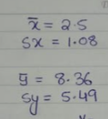
Question#4
The Q4 Is basically interconnected with Q2 there breakdown I'm going to write is related to q2
The Values I given in picture are the values which is taken from q2.
The solution for q4 is first of all we can find the square root of all x , y values and then we apply the formula of correlation coefficient which is given below in picture
After putting all the values and doing the sum of all answers of x and y values we will get the answer 0.990

Slide 7
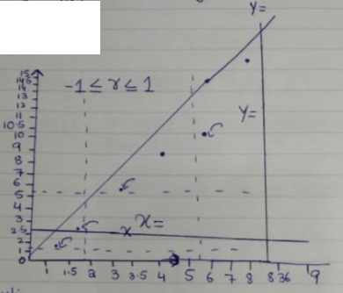
GRAPH FOR EXCERSICE 4

Slide 8
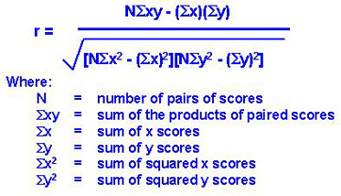
Question#5 There is table giving us the Indiana Polis qualifying speeds S from 1994 to 2011 There are four parts of the Q#4.
(A) Regression line and correlation coefficient is calculated by these steps.
The mean values of x and y are calculated.
The sum of the squared of x and y values and product of paired values of x and y.
Putting all values in equation we calculated regression line.
(B) Yes, linear model is reasonable for the data. As the value of r we get is close to +1. So, more data points lie on the line.
(C)
(D) The assumptions we made in part c are:
Time taken is zero.
The Correlation exists.
This is a linear model as value of r is close to +1. So, data points lie on regression line.

Slide 9
Non linear Models
Non linear Models are regressions plotted in the graph that do not follow the linear order. These models are divided into three type of regressions
1. Exponential Regression: When we have got a exponent in a function then the model Is non linear regression.
2. Logarithmic Regression: When we have a logarithmic term in the equation of a function.
3. Power Regression: set of (xi, yi) data will have a power function model if the transformed data (log xi, log yi have a linear model
Question 6:
Explanation: In this exercise there were 4 questions given to solve the non linear regressions.
In this an exponential function was given. After taking ln on both sides the equation was made linearized.
In this a logarithmic function from given but after also taking log from the both side we got a linearized equation and after plotting new values we got a linearized model.
In this question, a power function was given but to solve this I had to use lny and lnx as it depend on both variables then I solved it by using logarithmic rules and made it linearized model.
The last question was about the methods used, I just summarized them all and show that the natural and common logarithm had what difference

Slide 10
Question 7:
Explanation:
In this question, we were given a exponential function that was non linear regression and asked to linearized it and then use the data to make a new model that suits the linearized model. Then find the values of a and b
In the second part it was asked to make a scatter graph plane model.
Steps:
First of all the given equation was linearized by taking log on the both sides. Then new variables were taken as z = ln y and w = x
After doing this, a new data was made as the first data which was non linear regression taking place btw y and x plot but now it was z and w. Z being lny, so the values of y changed with the Calculated values through taking natural log.
For finding the values of a and b, I used a formula that took many new values that I got from Using the help of summation for regression. Then I substituted the values.
After that I got two equations. After equating them, I got ln(a) and the value of b.
Then I had to remove the ln as I didn’t Need that. I used calculator for finding the value of a.
Part 2: Scatter graph has been made of the new model which was linearized now.

Slide 11
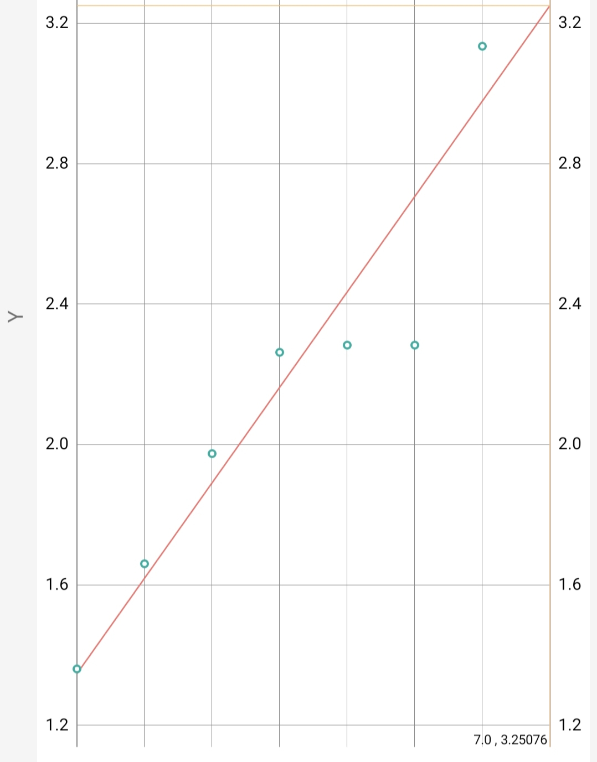
Graph for Exercise 7 #Part B

Slide 12
Question#8 Figure 6 shows the relationship between the time T that it takes for each planet in our solar system to make one revolution around the Sun and the mean distance d between the planet and the Sun during one revolution.
There are four parts of Q#8 which are answered below.
(A) The model suggested by the graph is POWER FUNCTION MODEL.
(B) In 1st the Sum of planets’ distances and time of revolution around the sun is calculated.
In 2nd the Mean of the distances and time of revolution has been taken.
In 3rd Summation of X and Y values are calculated. Standard deviation of x and y values is calculated.
In 4th R is calculated by formula.
In 5th Slope (m) is calculated by multiplying the coefficient with division of standard deviation of x and y values.
Finally, regression line is calculated by putting all these values.

Slide 13
(C) The T is expressed as function of d 1st the gradient is calculated. The x and y values of Earth is taken (0,0). The x and y values of Pluto are (1.6,2.4). Through Slope line equation we get, LOG T = 3/2* LOG d. Finally, we get the T as function of d. (D) Kepler's Third Law : the squares of the orbital periods of the planets are directly proportional to the cubes of the semi major axes of their orbits. It implies that the period for a planet to orbit the Sun increases rapidly with the radius of its orbit.
Modeling cooling
Here is the example that if coffee is let to cool and its temperature is approaching the rooms’ temperature. The difference between the temperature of the liquid and the temperature of the room has an exponential model.
T − Ta = (To − Ta)e^−kt equation which is called Newton’s Law of Cooling. K is a positive constant whose value depends on the physical characteristics of the liquid. This equation states that the difference between the temperature of the liquid and the temperature of the room has an exponential model.

Slide 14
Question#9
(A) T - Ta = ( To - Ta ) e^(-kt), by using this equation. It is given that that room is placed with a constant temperature of 27 °C .As given in the table that when t =1 , temperature in the room is 82.2 °C and when t=4, temperature in room is 75 °C.
Putting these values we get 2 equations, by dividing these equations we get the value of K, putting the value of K in equation in which we were given constant temperature.
T = 27 + ( To - 27 ) e^( (1/3) (ln 0.87) t ) Thus, we find the temperature T as function of elapsed time t
(B) When t = 4, T = 75 , putting these value in equation T = 27 + ( To - 27 ) e^( (1/3) (ln 0.87) t ) we get To = 84.8°C This is the initial temperature of the coffee. (C) The Time at which the temperature would be 5 degree from the room temperature at that point T is 32 is 52.726 min.

Slide 15
THE END THANK YOU!!

